Slide 1
CAM
CAM vs. RAM
Data In
0
1
0
1
0
1
0
1
0
1
0
1
1
0
0
0
1
1
1
0
1
1
0
0
0
0
2
1
1
0
1
0
0
1
1
0
1
0
1
0
1
0
1
0
3
1
0
1
1
1
1
0
1
1
1
0
1
1
0
0
0
0
4
Address In
4
1
0
1
1
0
0
0
1
2
1
1
0
1
0
0
1
1
3
1
0
1
1
0
0
0
1
Address Out
3
1
0
1
1
0
0
0
1
5
1
1
1
0
1
1
0
0
1
0
1
1
0
0
0
1
4
1
0
1
1
1
0
0
0
1
0
1
1
0
0
0
1
5
1
1
1
0
0
0
1
1
Data Out

Slide 2
CAM
Ternary CAM (TCAM)
Input Keyword
Input Keyword
1
0
1
1
0
X
X
X
1
0
1
1
0
0
0
1
0
1
0
1
0
X
0
1
0
1
0
1
0
1
0
1
0
1
0
1
1
1
0
1
1
0
1
0
1
1
0
0
0
1
0
1
1
0
1
0
1
1
1
0
1
1
0
0
0
X
Match
Match
2
1
X
0
1
0
0
1
1
2
1
1
0
1
0
0
X
X
3
1
0
1
1
1
0
0
0
4
3
1
0
1
1
1
X
X
X
4
4
1
0
1
1
0
1
0
1
1
1
0
1
1
0
0
1
0
4
1
0
1
1
X
X
X
X
Match
Match
5
1
1
1
0
0
X
0
0
5
1
1
1
X
X
X
X
X

Slide 3
CAM
Binary CAM Cell
ML pre-charged to V_{DD}
Match: ML remains at V_{DD}
Mismatch: ML discharges
SL1c
SL1
ML
N5
N7
BL1_cell
BL1c_cell
N6
N8
P1
P2
N4
N3
N1
N2
BL1c
BL1
WL

Slide 4
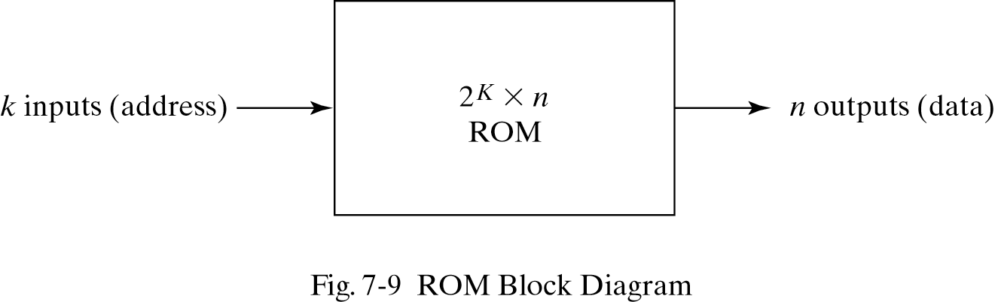
Read-Only Memory
A block diagram of a ROM is shown below. It consists of k address inputs and n data outputs.
The number of words in a ROM is determined from the fact that k address input lines are needed to specify 2^{k} words.
ROM Block diagram 2^{k} xn Module

Slide 5
Read-Only Memory Cells
Bit line (BL) is resistively clamped to the ground, so its default value is 0
Diode disadvantage – no electrical isolation between bit and word lines
BL is resistively clamped
to VDD, so its default
value is 1
BL
BL
BL
V_{DD}
WL
WL
WL
1
BL
BL
BL
WL
WL
WL
0
GND
Diode ROM
MOS ROM 1
MOS ROM 2

Slide 6
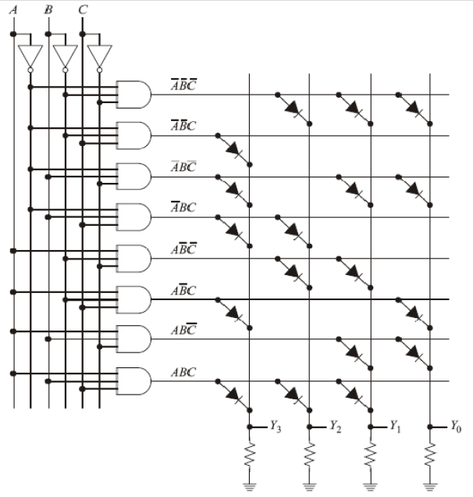
Nonvolatile Memory
ROM PROM EPROM
Read-only memory organization, with the fixed contents shown on the right.

Slide 7
MOS NOR ROM
V
DD
Pull-up devices
WL
[0]
GND
WL
[1]
WL
[2]
GND
WL
[3]
BL
[0]
BL
[1]
BL
[2]
BL
[3]

Slide 8
MOS NAND ROM
V
DD
Pull-up devices
BL
[0]
BL
[1]
BL
[2]
BL
[3]
WL
[0]
WL
[1]
WL
[2]
WL
[3]
All word lines high by default with exception of selected row

Slide 9
Flash Memory

Slide 10
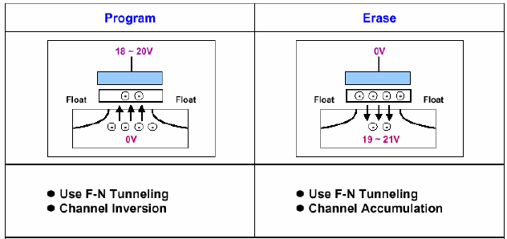
Flash memory
Flash memory
Non volatile read only memory (ROM)
Erase Electrically or UV (EPROM)
Uses F-N tunneling for program & erase
Reads like DRAM (~ns)
Writes like DISK (~ms).
Memory type | SRAM | DRAM | Flash
Speed | Very fast | fast | slow
Density | Low | High | Very high
Power | Low | High | Very low
Refresh | No | Yes | No
Mechanism | Bi-stable latch | Capacitor | FN tunneling
Notes:
Fowler–Nordheim tunneling

Slide 11
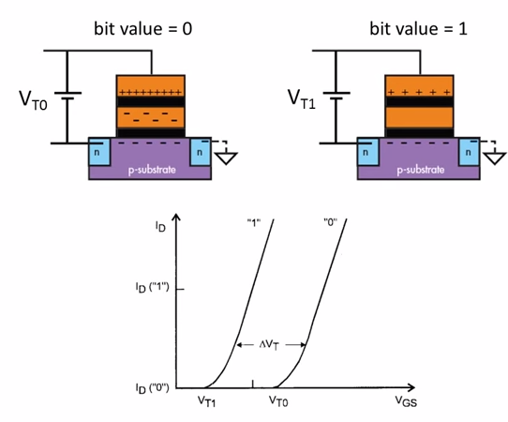
Reading Memory State
Change in Threshold Voltage due to Screening Effect of Floating Gate
Read mode: Apply intermediate voltage, check whether current is flowing or not

Slide 12
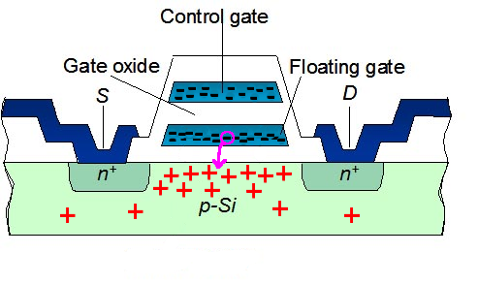
Writing Memory State
Control gate voltage determines whether electrons are injected to, or push/pulled out of floating gate.

Slide 13
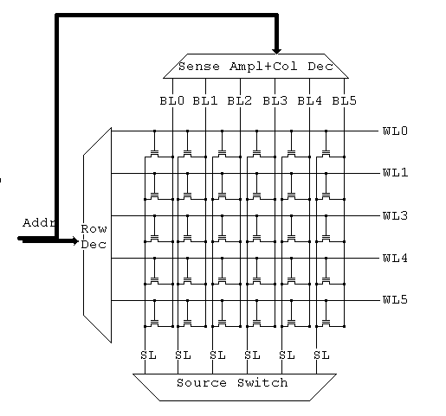
NOR Array
Reading:
Assert a single word line. The source lines are asserted and the read of the bitline gives the contents of the cell.

Slide 14
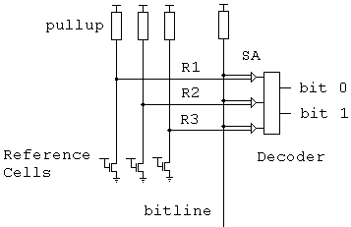
Multi-Levels
By using reference cells set at given levels and comparing them to the value from the bitline, we can determine the value stored.

Slide 15
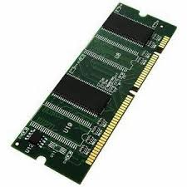
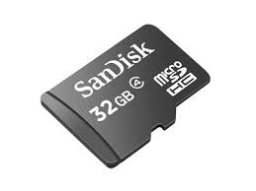
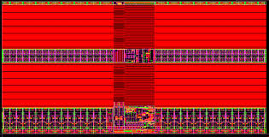
Review of memory technologies
Memory type | SRAM | DRAM | Flash
Speed | Very fast | Slow | Slow
Density | Low | High | Very high
Power | High | Low | Very low
Refresh | No | Yes | No
Mechanism | Bi-stable latch | Capacitor | FN tunneling
Notes:
Fowler–Nordheim tunneling

